Slide 1
R-CNN (4)
Rich feature hierarchies for accurate object detection and semantic segmentation
2024-12-26
Sein Choi
Intelligent Vision Processing Lab. (IVPL)
https://ivpl.sookmyung.ac.kr
Div. of AI Engineering, Sookmyung Women’s University
E-mail: csi1806@sookmyung.ac.kr

Slide 2
Contents
R-CNN
SVM
BBox regression
Output – Car detection

Slide 3
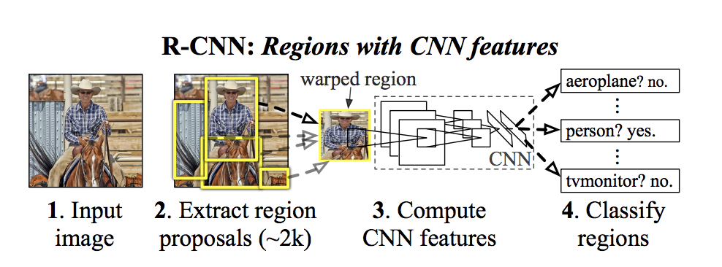
R-CNN training sequence

Slide 4
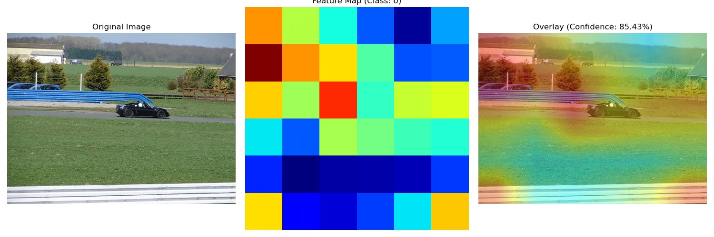
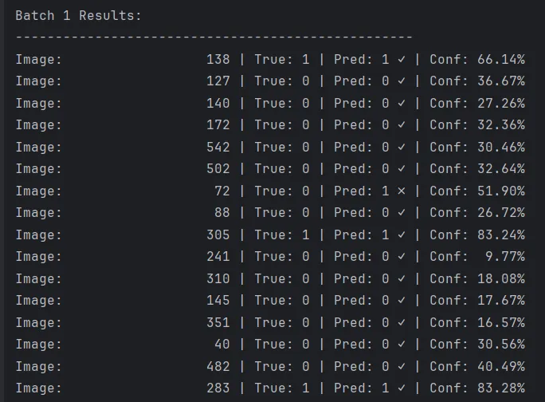
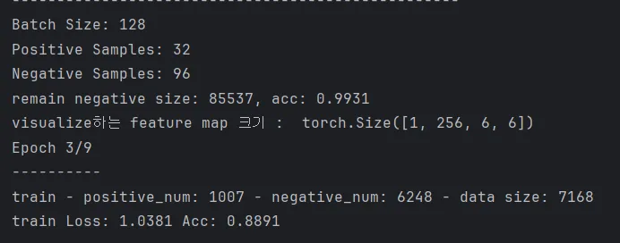
SVM output

Slide 5
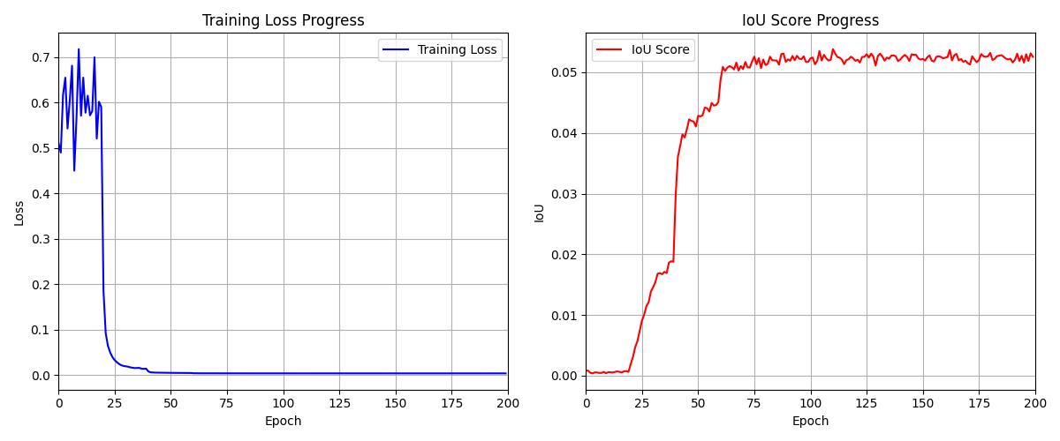
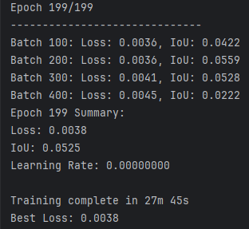
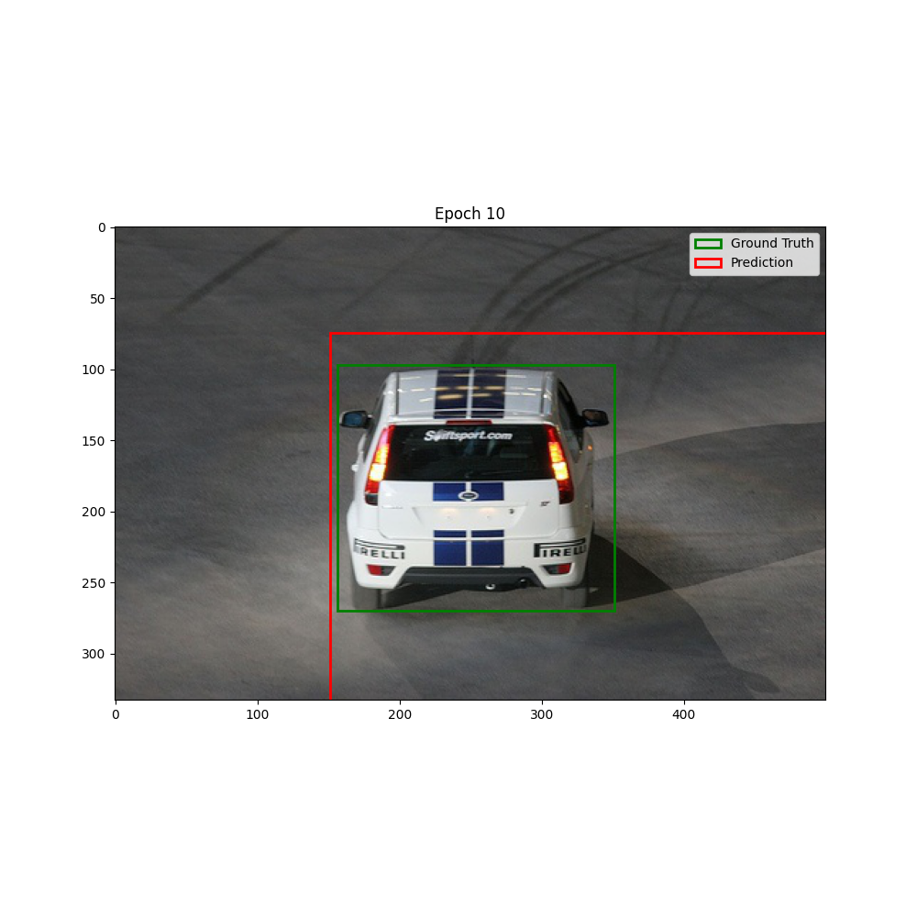
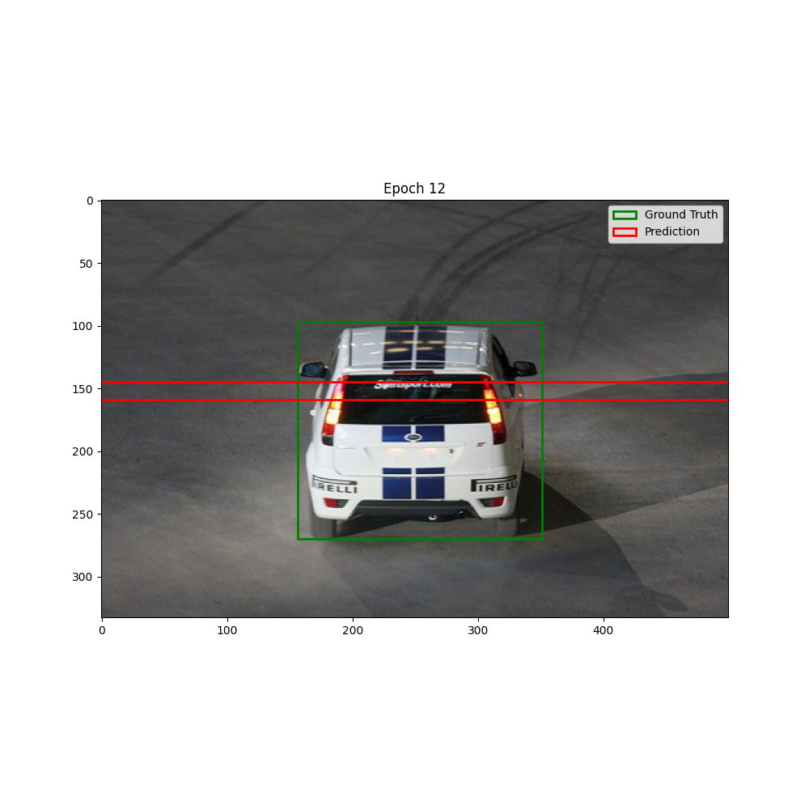
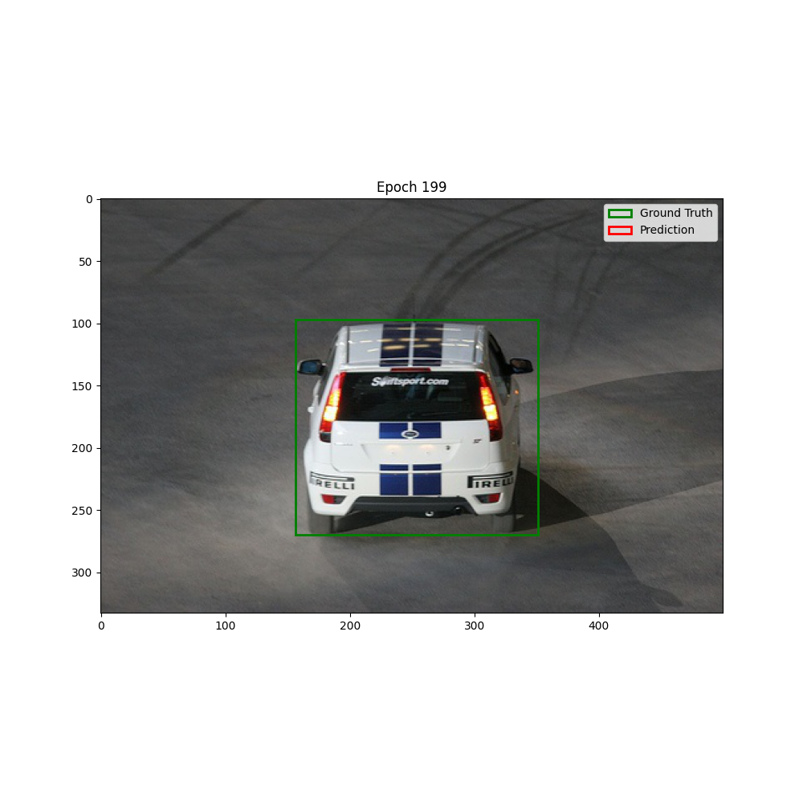
BBox regression output

Slide 6
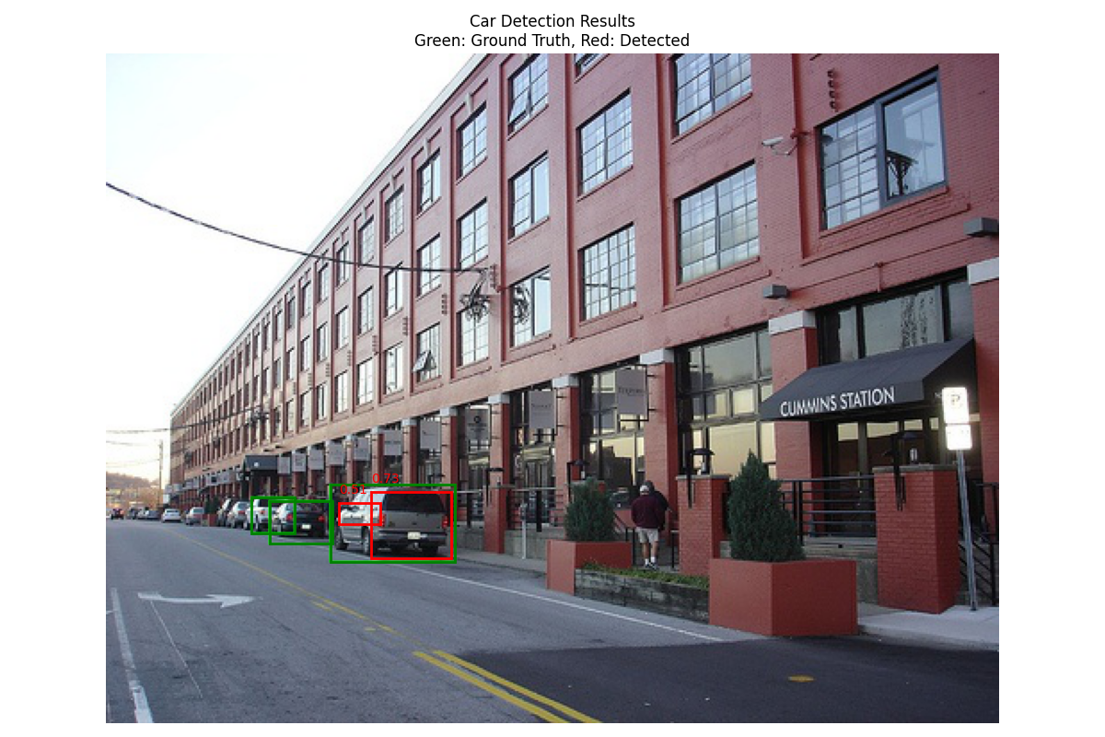
Car detection
svm_thresh = 0.1
IoU_thresh = 0.1

Slide 7
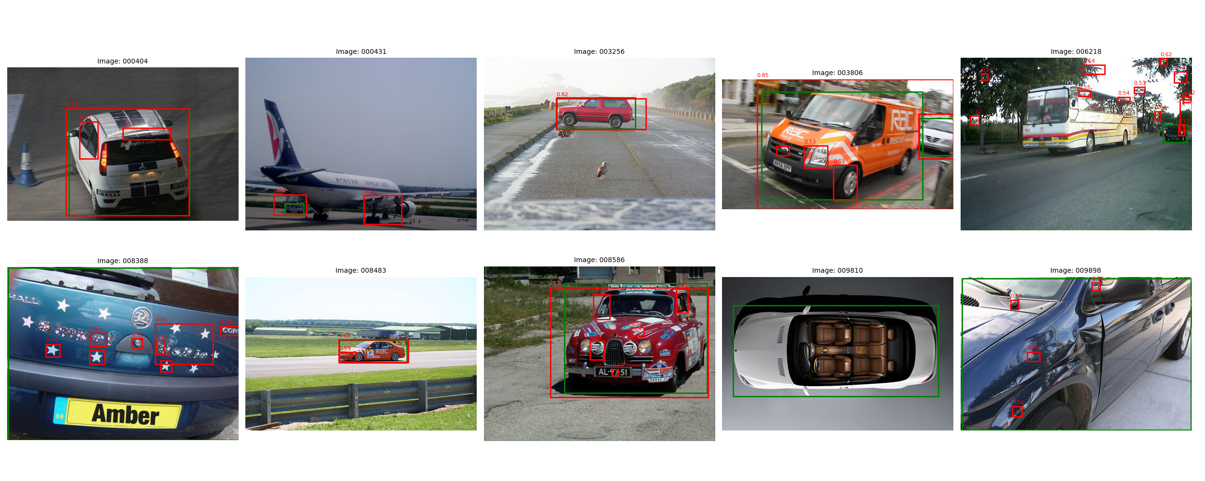
Cars detection
svm_thresh = 0.1
IoU_thresh = 0.1

Slide 8
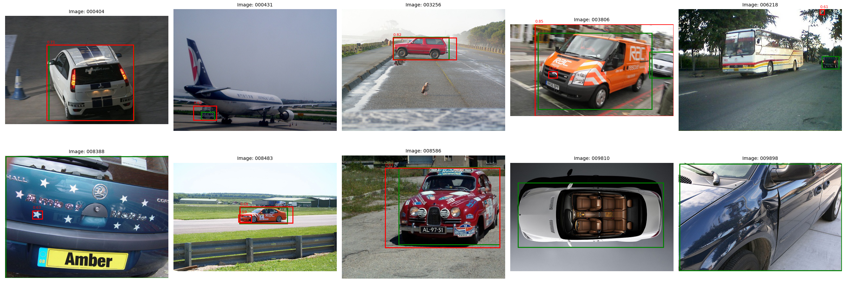
Cars detection
svm_thresh = 0.6
IoU_thresh = 0.3

Slide 9

Cars detection w.BBox weight

Slide 10
Thank you for your attention.!!!
QnA

